Slide 1
Unit – II Graph Algorithms Graphs representations, Graph traversal-Breadth First Search, Depth First Search with applications, Topological Sort, Dijstra's algorithms, Bellman-Ford Algorithm, Shortest paths in a DAG, Minimum Spanning Trees: Prim's and Kruskal's Algorithms with applications. Maximum Flow Flow networks, Ford Fulkerson method, Max Flow Min Cut theorem.

Slide 2


What is a graph?
56
Tokyo
Seattle
Seoul
128
16
181
New York
30
140
L.A.
Sydney

Slide 3
Graphs
graph: A data structure containing:
a set of vertices V, (sometimes called nodes)
a set of edges E, where an edge represents a connection between 2 vertices.
Graph G = (V, E)
an edge is a pair (v, w) where v, w are in V
the graph at right:
V = {a, b, c, d}
E = {(a, c), (b, c), (b, d), (c, d)}
degree: number of edges touching a given vertex.
at right: a=1, b=2, c=3, d=2
a
b
c
d

Slide 4
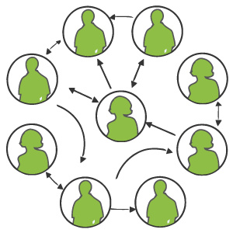
Graph examples
For each, what are the vertices and what are the edges?
Web pages with links
Methods in a program that call each other
Road maps (e.g., Google maps)
Airline routes
Facebook friends
Course pre-requisites
Family trees
Paths through a maze

Slide 5
Paths
path: A path from vertex a to b is a sequence of edges that can be followed starting from a to reach b.
can be represented as vertices visited, or edges taken
example, one path from V to Z: {b, h} or {V, X, Z}
What are two paths from U to Y?
path length: Number of vertices or edges contained in the path.
neighbor or adjacent: Two vertices connected directly by an edge.
example: V and X
V
a
b
U
d
X
Z
h
c
e
W
g
f
Y

Slide 6
Terminology
Path: a sequence of vertices (v[1], v[2],...,v[k]) s.t. (v[i],v[i+1]) ∈ E for all 0 < i < k
Simple Path: No vertex is repeated in a simple path
The length of a path is number of vertices in it minus 1.
Cycle : a simple path that begins and ends with the same node
Cyclic graph – contains at least one cycle
Acyclic graph - no cycles

Slide 7
Reachability, connectedness
reachable: Vertex a is reachable from b if a path exists from a to b.
connected: A graph is connected if every vertex is reachable from any other.
Is the graph at top right connected?
strongly connected: When every vertex has an edge to every other vertex.
V
a
b
U
d
X
Z
h
c
e
W
g
f
Y
a
b
a
b
d
c
e
c
d

Slide 8
Loops and cycles
cycle: A path that begins and ends at the same node.
example: {b, g, f, c, a} or {V, X, Y, W, U, V}.
example: {c, d, a} or {U, W, V, U}.
acyclic graph: One that does not contain any cycles.
loop: An edge directly from a node to itself.
Many graphs don't allow loops.
V
a
b
U
d
X
Z
h
c
e
W
g
f
Y

Slide 9
Weighted graphs
weight: Cost associated with a given edge.
Some graphs have weighted edges, and some are unweighted.
Edges in an unweighted graph can be thought of as having equal weight (e.g. all 0, or all 1, etc.)
Most graphs do not allow negative weights.
example: graph of airline flights, weighted by miles between cities:
849
PVD
1843
ORD
SFO
142
802
LGA
1743
337
1387
HNL
2555
1099
LAX
1233
DFW
1120
MIA

Slide 10
Directed graphs
directed graph ("digraph"): One where edges are one-way connections between vertices.
If graph is directed, a vertex has a separate in/out degree.
A digraph can be weighted or unweighted.
Is the graph below connected? Why or why not?
a
b
c
d
e
f
g

Slide 11
Digraph example
Vertices = UW CSE courses (incomplete list)
Edge (a, b) = a is a prerequisite for b
120
131
142
140
450
143
154
331
311
341
351
373
374
332
403
312
344
333
352
410
413
414
431
446
444
421
440
451
415
417
452

Slide 12
Graphs: Diagramatic representation
Vertices (aka nodes)

Slide 13
Graphs — Diagramatic Representation
Vertices (aka nodes)
3
2
1
4
5
6
Edges

Slide 14
Graphs — Weighted graphs
Vertices (aka nodes)
3
618
2
1
2273
211
190
4
318
344
1987
5
2145
2462
6
Weights
Undirected
Edges

Slide 15
Directed Graph (digraph)
Vertices (aka nodes)
3
2
1
4
5
6
Edges

Slide 16
Tree
A connected acyclic Graph is a tree.
Spanning tree of a connected graph G=(V,E): a sub graph T=(V,E’) of G, and T is a tree, i.e. T spans the whole of V of G.
W(T)= sum of the weights of all edges of T.
Minimum Spanning Tree ( MST): Spanning tree having minimum weight of a edge weighted connected graph.

Slide 17
Graph Representation
Two popular computer representations of a graph. Both represent the vertex set and the edge set, but in different ways.
Adjacency Matrix
Use a 2D matrix to represent the graph
Adjacency List
Use a 1D array of linked lists

Slide 18
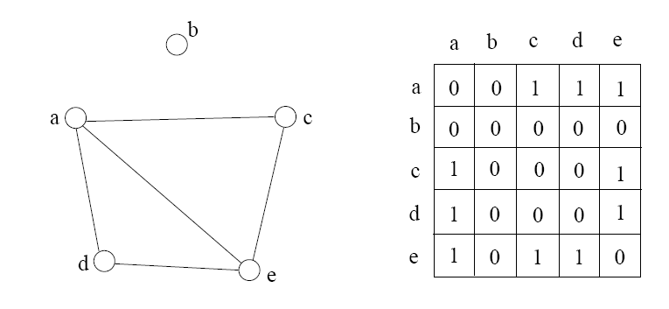
Adjacency Matrix
2D array A[0..n-1, 0..n-1], where n is the number of vertices in the graph
Each row and column is indexed by the vertex id
e,g a=0, b=1, c=2, d=3, e=4
A[i][j]=1 if there is an edge connecting vertices i and j;
otherwise, A[i][j]=0
The storage requirement is Θ(n²). It is not efficient if the graph has few edges. An adjacency matrix is an appropriate representation if the graph is dense: |E|=Θ(|V|²)
We can detect in O(1) time whether two vertices are connected.

Slide 19
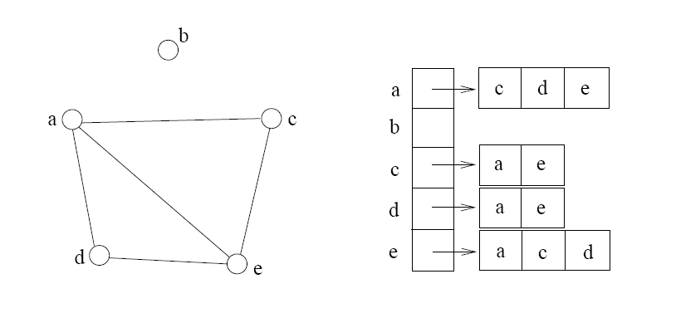
Adjacency List
If the graph is not dense, in other words, sparse, a better solution is an adjacency list
The adjacency list is an array A[0..n-1] of lists, where n is the number of vertices in the graph.
Each array entry is indexed by the vertex id
Each list A[i] stores the ids of the vertices adjacent to vertex i

Slide 20
Adjacency List vs. Matrix
Adjacency List
More compact than adjacency matrices if graph has few edges
Requires more time to find if an edge exists
Adjacency Matrix
Always require n² space
This can waste a lot of space if the number of edges are sparse
Can quickly find if an edge exists

Slide 21
Adjacency Matrix Example
0
 | 0 | 1 | 2 | 3 | 4 | 5 | 6 | 7 | 8 | 9
0 | 0 | 0 | 0 | 0 | 0 | 0 | 0 | 0 | 1 | 0
1 | 0 | 0 | 1 | 1 | 0 | 0 | 0 | 1 | 0 | 1
2 | 0 | 1 | 0 | 0 | 1 | 0 | 0 | 0 | 1 | 0
3 | 0 | 1 | 0 | 0 | 1 | 1 | 0 | 0 | 0 | 0
4 | 0 | 0 | 1 | 1 | 0 | 0 | 0 | 0 | 0 | 0
5 | 0 | 0 | 0 | 1 | 0 | 0 | 1 | 0 | 0 | 0
6 | 0 | 0 | 0 | 0 | 0 | 1 | 0 | 1 | 0 | 0
7 | 0 | 1 | 0 | 0 | 0 | 0 | 1 | 0 | 0 | 0
8 | 1 | 0 | 1 | 0 | 0 | 0 | 0 | 0 | 0 | 1
9 | 0 | 1 | 0 | 0 | 0 | 0 | 0 | 0 | 1 | 0
8
2
9
1
3
7
6
4
5

Slide 22
Adjacency List Example
0
0
1
2
3
4
5
6
7
8
9
8
2 | 3 | 7 | 9
8
1 | 4 | 8
2
9
1 | 4 | 5
1
2 | 3
7
3 | 6
3
6
5 | 7
4
5
1 | 6
0 | 2 | 9
1 | 8

Slide 23
Storage of Adjacency List
The array takes up Θ(n) space
Define degree of v, deg(v), to be the number of edges incident to v. Then, the total space to store the graph is proportional to:
An edge e={u,v} of the graph contributes a count of 1 to deg(u) and contributes a count 1 to deg(v)
Therefore, Σvertex vdeg(v) = 2m, where m is the total number of edges
In all, the adjacency list takes up Θ(n+m) space
If m = O(n²) (i.e. dense graphs), both adjacent matrix and adjacent lists use Θ(n²) space.
If m = O(n), adjacent list outperform adjacent matrix
However, one cannot tell in O(1) time whether two vertices are connected

Slide 24
Graph Traversals
BFS ( breadth first search)
DFS ( depth first search)
If S is implemented using a Queue, the search becomes BFS
If S is implemented using a stack, the search becomes DFS

Slide 25
Linked Lists, Trees, Graphs
A binary tree is a graph with some restrictions:
The tree is an unweighted, directed, acyclic graph (DAG).
Each node's in-degree is at most 1, and out-degree is at most 2.
There is exactly one path from the root to every node.
A linked list is also a graph:
Unweighted DAG.
In/out degree of at most 1 for all nodes.
F
B
K
A
B
C
D
A
E
H
G
J

Slide 26
Searching for paths
Searching for a path from one vertex to another:
Sometimes, we just want any path (or want to know there is a path).
Sometimes, we want to minimize path length (# of edges).
Sometimes, we want to minimize path cost (sum of edge weights).
What is the shortest path from MIA to SFO? Which path has the minimum cost?
$50
PVD
$70
ORD
SFO
$200
$130
$170
$80
LGA
$60
$140
HNL
$250
LAX
$120
$100
DFW
$110
MIA
$500

Slide 27
Graph Algorithms

Slide 28
Layer 2
Layer 1
Source S

Slide 29
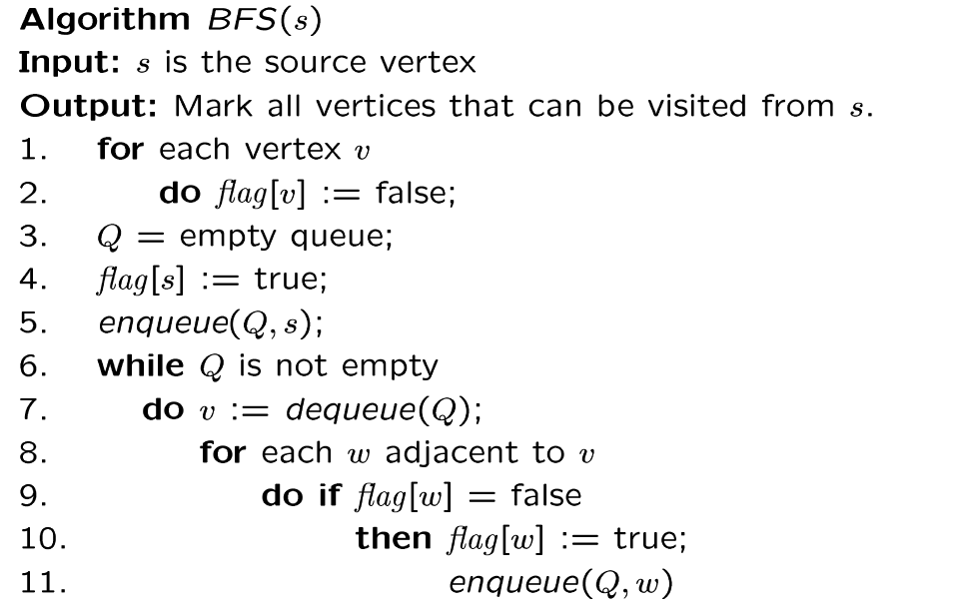
BFS Algorithm
// flag[ ]: visited table
Why use queue? Need FIFO

Slide 30
Illustration of BFS
0
1
0
2
4
2
1
4
9
5
9
10
10
5
7
11
8
6
7
8
11
6
BFS Tree
Graph G

Slide 31
BFS
for each vertex v
flag[v]=false;
For all vertices v
if (flag[v]=false) BFS(v);

Slide 32
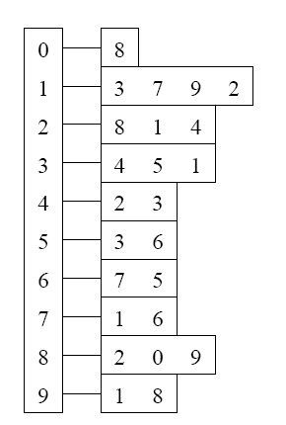
BFS Example
Adjacency List
Visited Table (T/F)
0
1
2
3
4
5
6
7
8
9
F
F
F
F
F
F
F
F
F
F
0
8
source
2
9
1
3
7
6
4
5
Initialize visited
table (all False)
Q =
{ }
Initialize Q to be empty

Slide 33
BFS Example
Adjacency List
Visited Table (T/F)
0
1
2
3
4
5
6
7
8
9
F
F
T
F
F
F
F
F
F
F
0
8
source
2
9
1
3
7
6
4
5
Flag that 2 has
been visited
Q =
{2}
Place source 2 on the queue

Slide 34
BFS Example
Adjacency List
Visited Table (T/F)
0
1
2
3
4
5
6
7
8
9
F
T
T
F
T
F
F
F
T
F
0
8
Neighbors
source
2
9
1
3
7
6
4
5
Mark neighbors
as visited 1, 4, 8
Q =
{2} → { 8, 1, 4 }
Dequeue 2.
Place all unvisited neighbors of 2 on the queue

Slide 35
BFS Example
Adjacency List
Visited Table (T/F)
0
1
2
3
4
5
6
7
8
9
T
T
T
F
T
F
F
F
T
T
0
8
source
2
9
1
3
7
Neighbors
6
4
5
Mark new visited
Neighbors 0, 9
Q =
{ 8, 1, 4 } → { 1, 4, 0, 9 }
Dequeue 8.
-- Place all unvisited neighbors of 8 on the queue.
-- Notice that 2 is not placed on the queue again, it has been visited!

Slide 36
BFS Example
Adjacency List
Visited Table (T/F)
0
1
2
3
4
5
6
7
8
9
T
T
T
T
T
F
F
T
T
T
0
Neighbors
8
source
2
9
1
3
7
6
4
5
Mark new visited
Neighbors 3, 7
Q =
{ 1, 4, 0, 9 } → { 4, 0, 9, 3, 7 }
Dequeue 1.
-- Place all unvisited neighbors of 1 on the queue.
-- Only nodes 3 and 7 haven’t been visited yet.

Slide 37
BFS Example
Adjacency List
Visited Table (T/F)
0
1
2
3
4
5
6
7
8
9
T
T
T
T
T
F
F
T
T
T
0
8
source
2
9
Neighbors
1
3
7
6
4
5
Q =
{ 4, 0, 9, 3, 7 } → { 0, 9, 3, 7 }
Dequeue 4.
-- 4 has no unvisited neighbors!

Slide 38
BFS Example
Adjacency List
Visited Table (T/F)
Neighbors
0
1
2
3
4
5
6
7
8
9
T
T
T
T
T
F
F
T
T
T
0
8
source
2
9
1
3
7
6
4
5
Q =
{ 0, 9, 3, 7 } → { 9, 3, 7 }
Dequeue 0.
-- 0 has no unvisited neighbors!

Slide 39
Adjacency List
Visited Table (T/F)
0
1
2
3
4
5
6
7
8
9
T
T
T
T
T
F
F
T
T
T
0
8
source
2
9
1
3
7
6
4
5
Neighbors
Q =
{ 9, 3, 7 } → { 3, 7 }
Dequeue 9.
-- 9 has no unvisited neighbors!

Slide 40
Adjacency List
Visited Table (T/F)
0
1
2
3
4
5
6
7
8
9
T
T
T
T
T
T
F
T
T
T
0
8
Neighbors
source
2
9
1
3
7
6
4
5
Mark new visited
Vertex 5
Q =
{ 3, 7 } → { 7, 5 }
Dequeue 3.
-- place neighbor 5 on the queue.

Slide 41
Adjacency List
Visited Table (T/F)
0
1
2
3
4
5
6
7
8
9
T
T
T
T
T
T
T
T
T
T
0
8
source
2
9
1
7
Neighbors
3
6
4
5
Mark new visited
Vertex 6
Q =
{ 7, 5 } → { 5, 6 }
Dequeue 7.
-- place neighbor 6 on the queue

Slide 42
Adjacency List
Visited Table (T/F)
0
1
2
3
4
5
6
7
8
9
T
T
T
T
T
T
T
T
T
T
0
8
source
2
9
Neighbors
1
3
7
6
4
5
Q =
{ 5, 6} → { 6 }
Dequeue 5.
-- no unvisited neighbors of 5

Slide 43
Adjacency List
Visited Table (T/F)
0
1
2
3
4
5
6
7
8
9
T
T
T
T
T
T
T
T
T
T
0
8
source
2
9
1
Neighbors
3
7
6
4
5
Q =
{ 6 } → { }
Dequeue 6.
-- no unvisited neighbors of 6

Slide 44
Adjacency List
Visited Table (T/F)
0
1
2
3
4
5
6
7
8
9
T
T
T
T
T
T
T
T
T
T
0
8
source
2
9
1
3
7
6
4
5
What did we discover?
Look at “visited” tables.
There exists a path from source
vertex 2 to all vertices in the graph
Q =
{ }
STOP!!! Q is empty!!!

Slide 45
Time Complexity of BFS (Using Adjacency List)
Assume adjacency list
n = number of vertices m = number of edges
O(n + m)
Each vertex will enter Q at most once.
Each iteration takes time proportional to deg(v) + 1 (the number 1 is to account for the case where deg(v) = 0 --- the work required is 1, not 0).

Slide 46
Running Time
Recall: Given a graph with m edges, what is the total degree?
The total running time of the while loop is:
this is summing over all the iterations in the while loop!
Σ_{vertex v} deg(v) = 2m
O( Σ_{vertex v} (deg(v) + 1) ) = O(n+m)

Slide 47
Time Complexity of BFS (Using Adjacency Matrix)
Assume adjacency Matrix
n = number of vertices m = number of edges
O(n²)
Finding the adjacent vertices of v requires checking all elements in the row. This takes linear time O(n).
Summing over all the n iterations, the total running time is O(n²).
So, with adjacency matrix, BFS is O(n²) independent of the number of edges m.
With adjacent lists, BFS is O(n+m); if m=O(n²) like in a dense graph, O(n+m)=O(n²).

Slide 48
What Can you do with BFS?
Find all the connected components
Test whether G has a cycle or not
Find a spanning tree of a connected graph
Find shortest paths from s to every other vertices
Test whether a graph has an odd cycle
Many more!!!

Slide 49
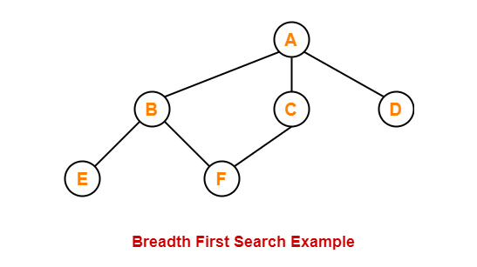

BFS Example

Slide 50
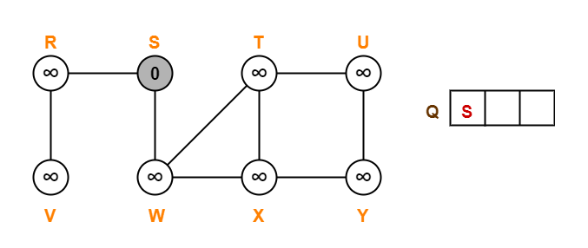
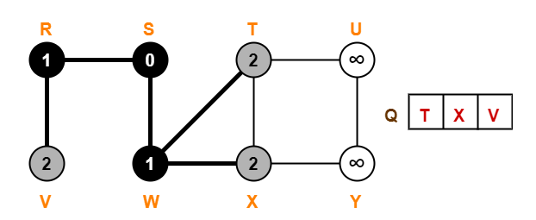
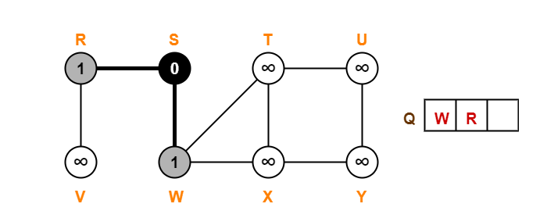
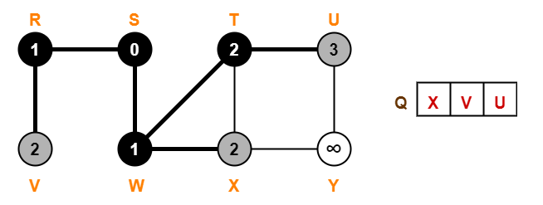
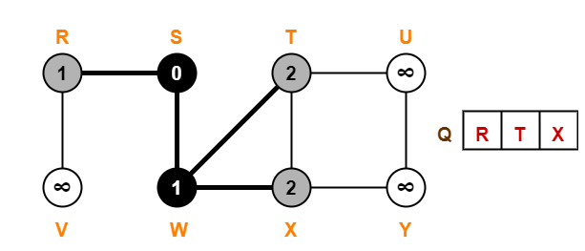
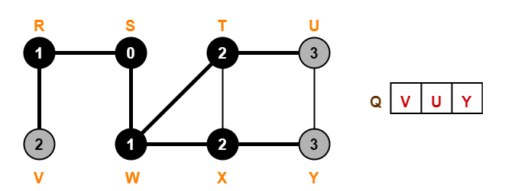
BFS Example

Slide 51
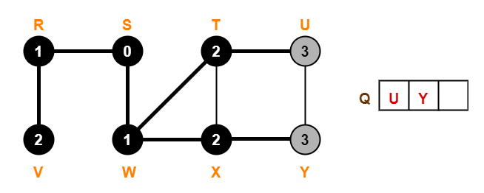
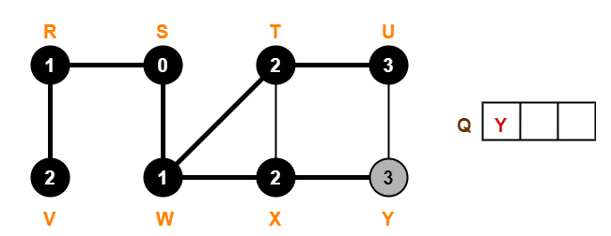
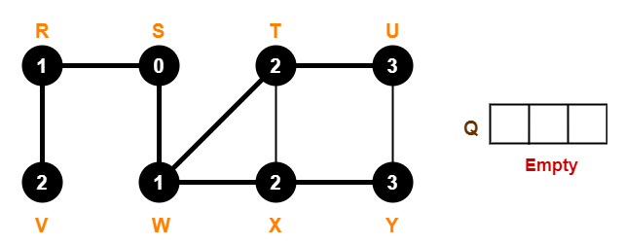
BFS Example

Slide 52
Depth-First Search in Directed Graphs

Slide 53






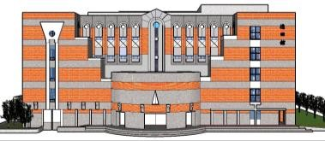



Search as deep as possible and then backtrack until finding a new path
12 13
9 10
8 11
1 14
2 7
4 5
3 6
Timestamps: discovery time / finishing time

Slide 54
DFS Algorithm
Initialize all vertices UNMARKED.
For u = 1 … n
if u is UNMARKED DFS(u)
DFS(u) {
MARK u
for all out-neighbours v of u if v is UNMARKED
DFS(v);
u
v
w
x
y
z
}

Slide 55
DFS Algorithm: DFS Tree
Initialize all vertices UNMARKED.
For u = 1 … n
if u is UNMARKED DFS(u)
DFS(u) {
MARK u
for all out-neighbours v of u if v is UNMARKED
DFS(v); parent(v)=u;
u
v
w
x
y
z
}

Slide 56
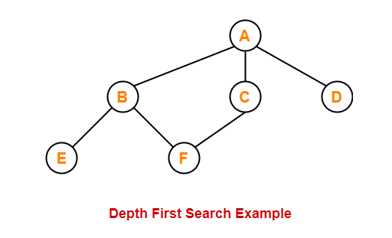

DFS example

Slide 57
Illustration of DFS
0
1
0
2
1
4
4
9
10
5
7
2
11
8
5
9
6
7
11
6
Graph G
8
10
DFS Tree

Slide 58
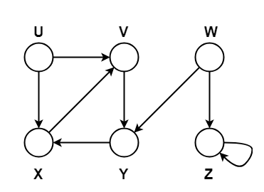
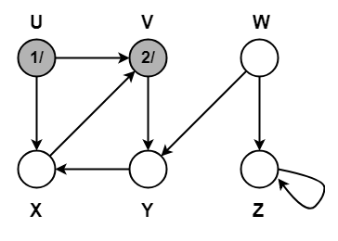
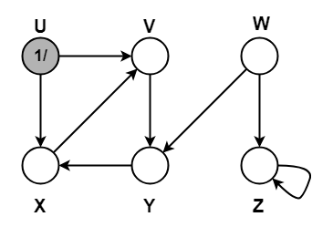
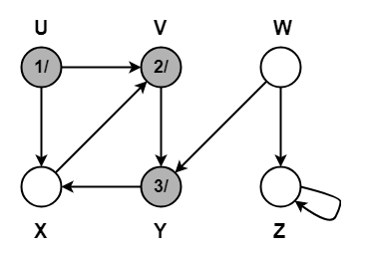
DFS example

Slide 59
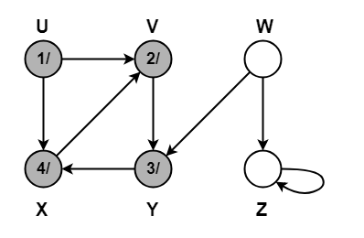
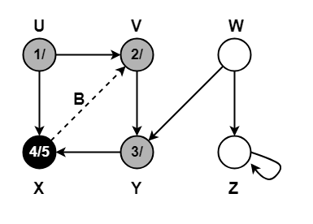
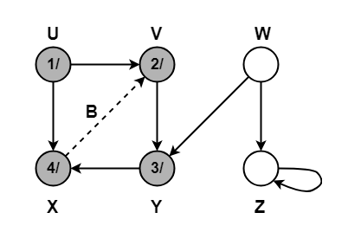
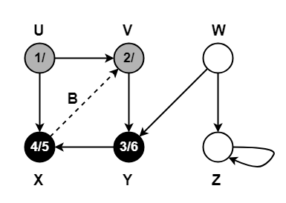
DFS example

Slide 60
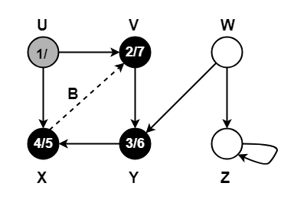
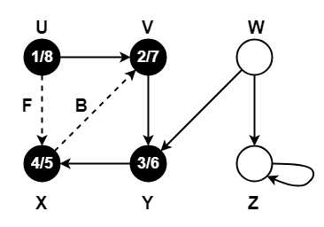
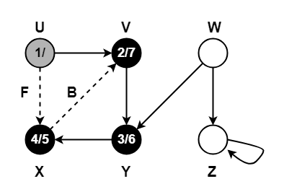
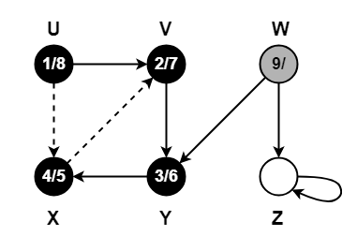
DFS example

Slide 61
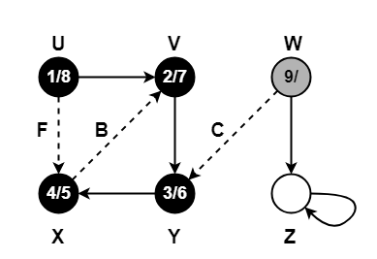
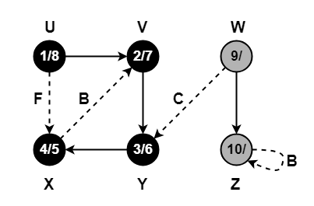
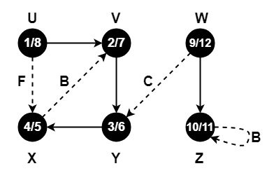
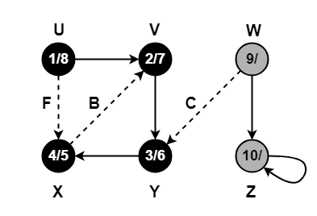
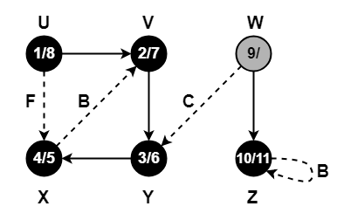
DFS example

Slide 62
Directed Depth First Search
A
Adjacency Lists
A: F G B: A H C: A D D: C F E: C D G F: E: G: : H: B: I: H:
B
H
C
G
I
D
F
E

Slide 63
Directed Depth First Search
A
B
H
C
G
I
D
F
E
dfs(A)
A-F A-G
Function call stack:

Slide 64
Directed Depth First Search
A
B
H
C
G
I
D
visit(F)
F-E
F
E
dfs(A)
A-F A-G
Function call stack:

Slide 65
Directed Depth First Search
A
B
H
C
G
I
dfs(E)
E-C E-D E-G
D
dfs(F)
F-E
F
E
dfs(A)
A-F A-G
Function call stack:

Slide 66
Directed Depth First Search
A
dfs(C)
C-A C-D
B
H
C
G
I
dfs(E)
E-C E-D E-G
D
dfs(F)
F-E
F
E
dfs(A)
A-F A-G
Function call stack:

Slide 67
Directed Depth First Search
A
dfs(C)
C-A C-D
B
H
C
G
I
dfs(E)
E-C E-D E-G
D
dfs(F)
F-E
F
E
dfs(A)
A-F A-G
Function call stack:

Slide 68
Directed Depth First Search
A
dfs(D)
D-C D-F
dfs(C)
C-A C-D
B
H
C
G
I
dfs(E)
E-C E-D E-G
D
dfs(F)
F-E
F
E
dfs(A)
A-F A-G
Function call stack:

Slide 69
Directed Depth First Search
A
dfs(D)
D-C D-F
dfs(C)
C-A C-D
B
H
C
G
I
dfs(E)
E-C E-D E-G
D
dfs(F)
F-E
F
E
dfs(A)
A-F A-G
Function call stack:

Slide 70
Directed Depth First Search
A
dfs(D)
D-C D-F
dfs(C)
C-A C-D
B
H
C
G
I
dfs(E)
E-C E-D E-G
D
dfs(F)
F-E
F
E
dfs(A)
A-F A-G
Function call stack:

Slide 71
Directed Depth First Search
A
dfs(C)
C-A C-D
B
H
C
G
I
dfs(E)
E-C E-D E-G
D
dfs(F)
F-E
F
E
dfs(A)
A-F A-G
Function call stack:

Slide 72
Directed Depth First Search
A
B
H
C
G
I
dfs(E)
E-C E-D E-G
D
dfs(F)
F-E
F
E
dfs(A)
A-F A-G
Function call stack:

Slide 73
Directed Depth First Search
A
B
H
C
G
I
dfs(E)
E-C E-D E-G
D
dfs(F)
F-E
F
E
dfs(A)
A-F A-G
Function call stack:

Slide 74
Directed Depth First Search
A
dfs(G)
B
H
C
G
I
dfs(E)
E-C E-D E-G
D
dfs(F)
F-E
F
E
dfs(A)
A-F A-G
Function call stack:

Slide 75
Directed Depth First Search
A
B
H
C
G
I
dfs(E)
E-C E-D E-G
D
dfs(F)
F-E
F
E
dfs(A)
A-F A-G
Function call stack:

Slide 76
Directed Depth First Search
A
B
H
C
G
I
D
dfs(F)
F-E
F
E
dfs(A)
A-F A-G
Function call stack:

Slide 77
Directed Depth First Search
A
B
H
C
G
I
D
F
E
dfs(A)
A-F A-G
Function call stack:

Slide 78
Directed Depth First Search
A
B
H
C
G
I
D
F
E
dfs(A)
A-F A-G
Function call stack:

Slide 79
Directed Depth First Search
A
B
H
C
G
I
D
F
E
Nodes reachable from A: A, C, D, E, F, G

